Slide 1

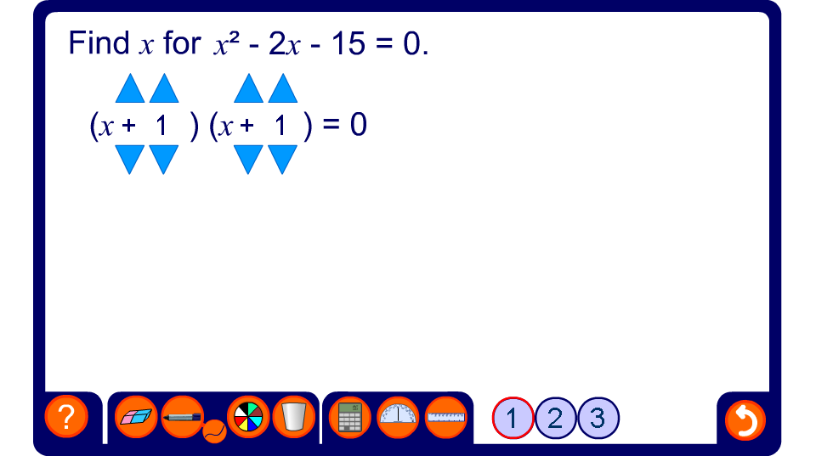


Solving quadratic equations by factorization
Notes:
It may be a good idea to practice adding and multiplying negative numbers before attempting this activity. See the activity in N1.2 Calculating with integers.

